Slide 1
CHANGES IN INVENTORY
Buyung Airlangga

Slide 2
CHANGES IN INVENTORY
Changes in inventories are measured by :
acquisition value of inventory;
Minus disposal value of inventory;
Minus the value of losses.
Types of inventory :
Materials and supplies;
Work in progress;
Finished goods;
Goods for resale;
Goods in transit

Slide 3
TIME OF RECORDING AND EVALUATION
Time of recording
Must be consistent with the time of recording of other production transactions such as intermediate inputs, outputs and GFCF
Evaluation
Gains/losses due to changes in prices is excluded;
Acquisition to the inventory - recorded at the current price of the goods entered;
Disposal from inventory - are recorded at current prices of goods sell-out.

Slide 4
INVENTORY ASSESSMENT AND MEASUREMENT
Historic costs – basis of accounting firms
First-In-First-Out (FIFO)
Disposal - valued on the price of the oldest items
Acquisition – valued on the price of the latest items
Last-In-First-Out (LIFO)
Disposal - valued on the price of the latest items
Acquisition – valued on the price of the oldest items
Weighted average prices
Required information for the value and volume of inventory
Average Prices are calculated on the basis of unit value
This price is used to obtain the book value of assets at the end of period

Slide 5
INVENTORY ASSESSMENT (EXAMPLE)
BASIC DATA
(A) Book value : end of September = 1000
end of December = 1600
(B) Inventories price index (basic year= 100)
September = 126
October = 130
November = 131
Desember = 135
COUNTING
(C) Inventory level at constant prices
end of September = 794 = (1000 x100/126)
end of Desember = 1185 = (1600 x 100/135)
(D) Changes of inventory at constant prices = 391 = (1185-794)
(E) Changes of inventory at current prices = 516 =
(391 x ((130+131+135)/3)/100)
(F) Holding gain = 84 = (1600-1000)-516

Slide 6
ESTIMATED CHANGES IN INVENTORY
= acquisition value–disposal value– recurrent losses, or
= (volume of inventory at closing – volume inventory at the opening) * average price during the period, or
= value at the end of inventory– value at the beginning of inventory

Slide 7
Method of Calculating Changes in Inventories
Source of data :
Livestock from Director General of Farms, Ministry of Agriculture
Plantation Commodities from economic indicators.
Mining commodities from statistics of mining
Manufacture from the statistics of manufacturing industry
Timber from statistics forestry
Financial reports of corporations listed in Indonesia’s stock exchange
Price / price index (PPI, WPI)

Slide 8
Inventory by sector (as benchmark)
growth Value based on field survey and inventory from financial reports
Inventories current prices
Appropriate price index
Changes in Inventories current prices
Appropriate price index
Changes in Inventories constant prices
Inventories constant prices

Slide 9
Inventories .... Continued
Estimation methods
For available commodities data, calculate the position of inventory at constant price by multiplying the base year volumes and prices of each commodity
Calculating changes in inventory by subtracting the position of inventory year t with year t-1
Calculate the change in inventories at current price by multiplying civ at constant price with an appropriate price index

Slide 10
Inventories .... Continued
data from financial statement
Calculate the position of inventory at constant price by deflating beginning and ending inventories with price index at end of the year.
Calculate changes in inventory by subtracting the position of inventory year t with year t-1
Due to data limitations, it is advised to calculate changes in inventory with a direct approach through the financial statements / field survey

Slide 11
VALUABLES

Slide 12
Valuation of valuable = acquisition – disposal of valuable
Characteristics of valuables
Non-financial goods
Usually not used for the production and consumption
Not damaged by time
Held as a valuable reserve

Slide 13
TYPE OF VALUABLE GOODS
Stones and precious metals
Diamond
Non-monetary gold
Platinum
Silver
Antiques and other art object
Painting
Sculpture
Others valuable goods
Jewelry that does not come from the stones and precious metals
Collectors items

Slide 14
TYPE OF VALUABLE GOODS (EXPOSURE)
The following items are considered valuable as an addition or disposal of valuables :
gold, silver etc. are non-monetary by central banks and other financial intermediaries;
the acquisition or disposal of valuable by a company which main activity is production of or trade in such goods (i.e., acquisition or disposal does not include input of capital formation of the company);
the acquisition or disposal of valuable goods by households are not included in household final consumption.

Slide 15
VALUATION OF VALUABLE
The production of valuables - valued at basic price
The acquisition of valuable goods - valued at purchaser prices
Including commission
Including trade margins when bought from dealers
Disposal of valuables – valued at the price received by sellers
Exclude commission paid to intermediary or agent
Acquisition less disposal of valuables between residents will cancel each other out and what remains is the margin of trading

Slide 16
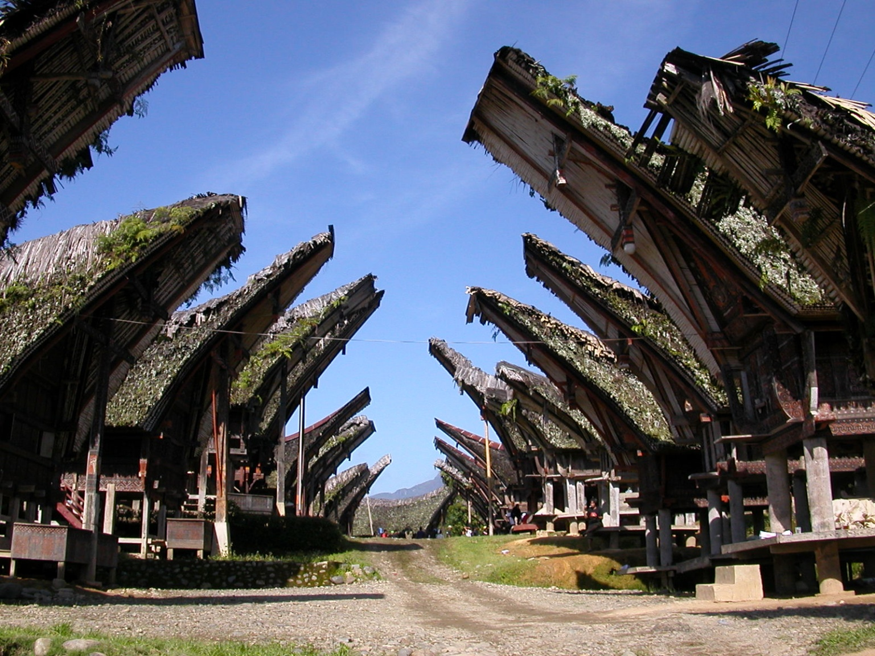
Thank you

